Slide 1
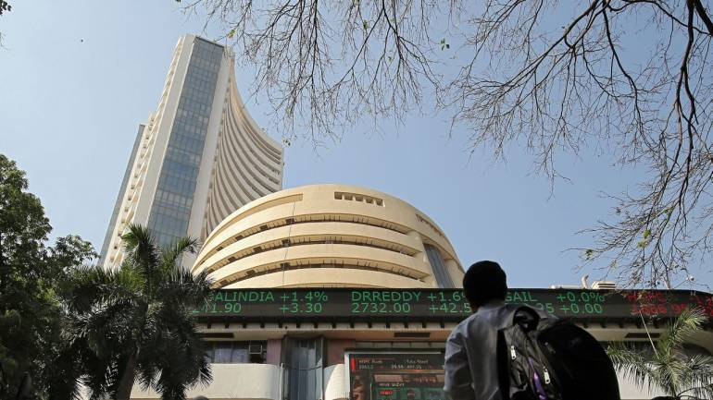

Slide 2


Slide 3

INTRODUCTION

Slide 4



TASK ALLOCATED: Develop a Stock Screener
Utsav Dhillon
utsavd987@gmail.com
Python Developer Intern at Hackveda

Slide 5
TABLE OF CONTENT
Introduction
Understanding Stock Screener
Purpose of Stock Screener
Implementation
Output
Demo
Conclusion and Use Case
Q&S session

Slide 6
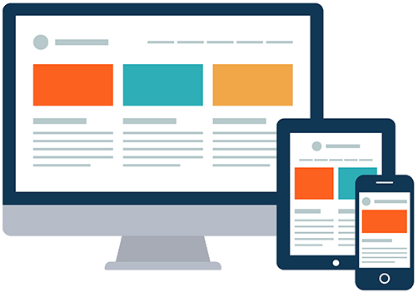
STOCK SCREENER
A stock screener is a powerful tool used by traders and investors to filter through thousands of stocks, identifying those that meet specific criteria and investment objectives. It allows us to sort and sift through the financial markets, helping us discover opportunities and make informed choices.
Stock screeners can be used for a variety of purposes, including:
Finding new investment opportunities
Identifying stocks that are undervalued or overvalued
Creating a watchlist of stocks to track
Developing and testing investment strategies

Slide 7
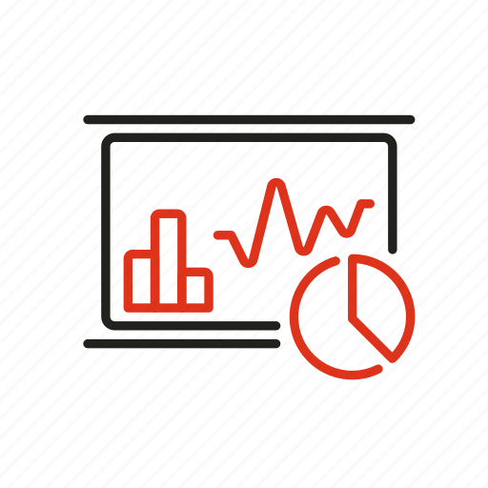
NEED??
There are many reasons why investors need stock screeners. First, there are thousands of stocks to choose from, and it can be difficult to keep track of all of them. Second, stock prices can change rapidly, so it is important to be able to quickly identify stocks that meet your investment criteria. Third, stock screeners can help you to avoid making emotional decisions. stock screeners are a valuable tool for investors of all levels of experience. They can help you to save time, identify new investment opportunities, make more informed investment decisions, and reduce risk.

Slide 8

KEY FEATURES
Criteria selection
Data retrieval
Filters and sorting
Alert notifications
Visualization of stock screener

Slide 9

IMPLEMENTATION
To develop a stock screener application using Python, you will need to:
Import the necessary libraries, such as pandas, numpy, yfinance, matplotlib, and seaborn.
Collect stock data from a data source, such as the Yahoo Finance API.
Clean and prepare the data.
Develop a model to screen the stocks.
Evaluate the model.
Deploy the application.

Slide 10
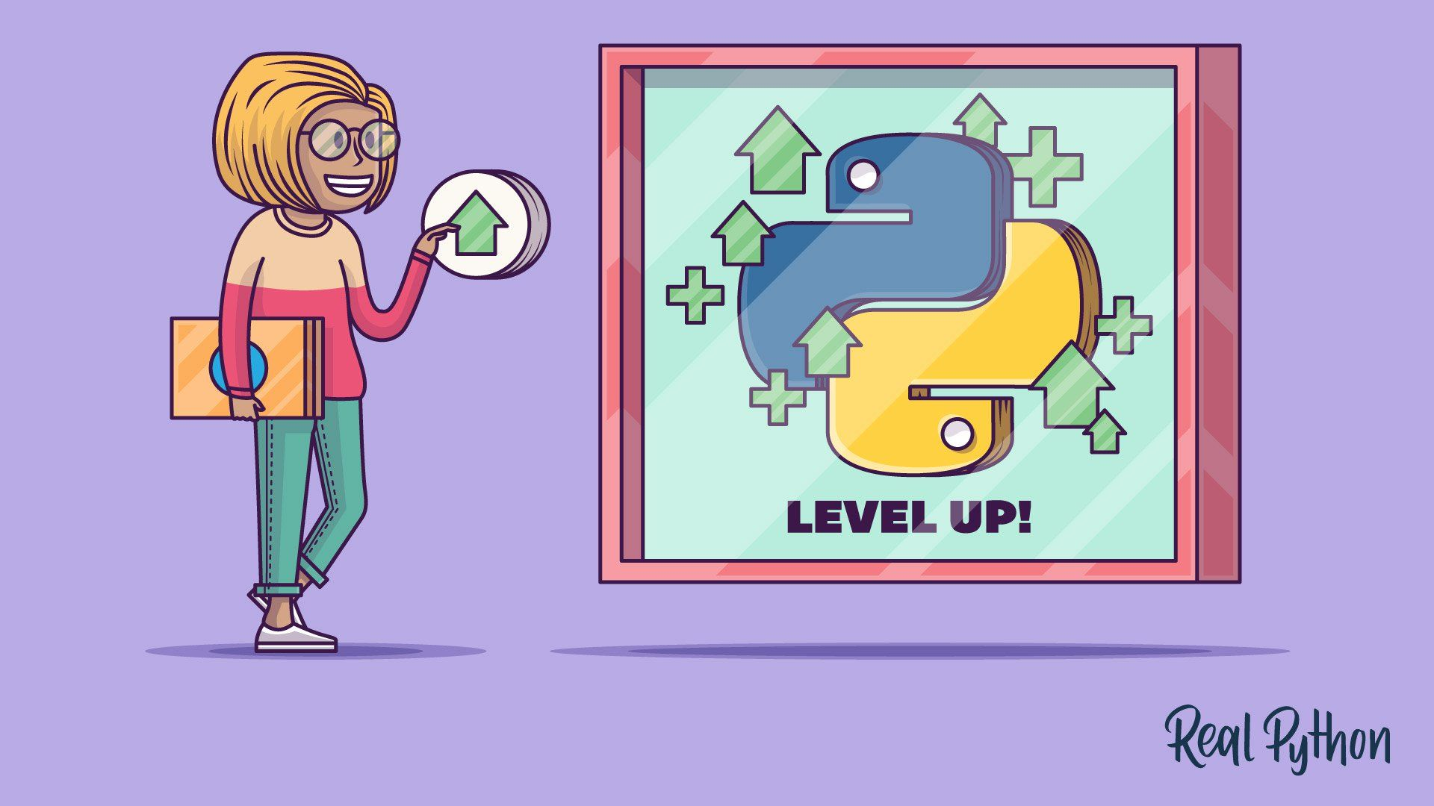
LIBRARIES
pandas: A library for data analysis and manipulation.
numpy: A library for scientific computing.
yfinance: A library for financial data retrieval and analysis.
nsepy: A library for financial data retrieval and analysis.

Slide 11

DEMO

Slide 12

Conclusion
A stock screener is a tool that helps investors to identify and sort through stocks based on their specific criteria.
You can use a variety of machine learning algorithms to develop sophisticated models for screening stocks.
There are many ways to enhance or improve a stock screener application. For example, you could add new criteria to the filter, such as technical indicators or analyst ratings. You could also use more sophisticated machine learning algorithms to develop a more accurate model for screening stocks.

Slide 13


ANY QUESTIONS??
Connect with me: utsavd987@gmail.com

Slide 14

THANK YOU

